Slide 1
UBER DEMAND SUPPLY GAP ANALYSIS
Sushma Subburayan

Slide 2
UBER DEMAND SUPPLY GAP ANALYSIS
OBJECTIVE:
The objective of this analysis is to identify the root cause of the demand supply gap of the cars and find the ways to improve the situation.
DATA SOURCE:
We have real time data from Uber
Uber Request Data.csv
GOALS OF THE ANALYSIS
Understand the reasons for the demand supply gap of the cars and suggest the solutions to improve the situation.
CONSTRAINTS
Only the trips to and from the airport are being considered.

Slide 3
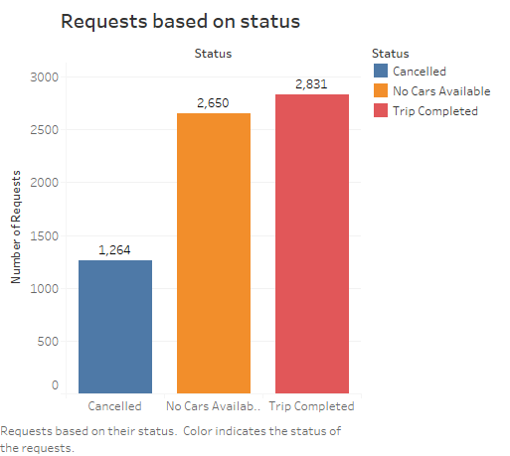
REQUESTS BASED ON THE STATUS
The adjacent graph shows the number of requests based on the status.
It clearly indicates that of the total requests made,
2831 Requests were completed, which is around 41.9% of the total requests made.
2650 Requests could not be completed because no cars were available which is around 39.2% of the total requests made.
1264 Requests were cancelled, which is around 39.2% of the total requests made.
More than 50% of the requests could not be completed which leads to loss on potential revenue

Slide 4
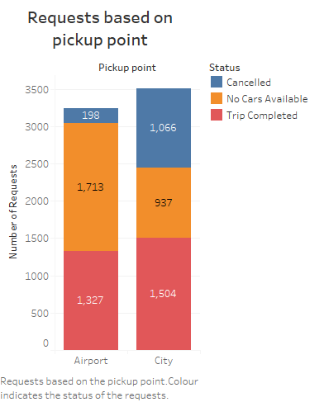
REQUESTS BASED ON THE PICKUP POINT
The adjacent graph shows the number of requests based on the pickup point.
It clearly indicates that
There is no significant difference in the number of requests made based on the pickup point .City to Airport is slightly on a higher side compared to Airport to City.
There is no significant difference in the number requests completed based on the pickup point
The number of requests for which no cars were available are more from Airport to city than from City to Airport. The probable reason might be that the drivers who drop the passengers at Airport might not be comfortable waiting for the arrival of the next flight
The number of requests which were cancelled were more from City to Airport than from Airport to City. The probable reasons might be that the pickup point is too far from Airport or the drivers will have to wait too long to get the next request back to city from the Airport as the requests would be based on the arrival of the next flight

Slide 5
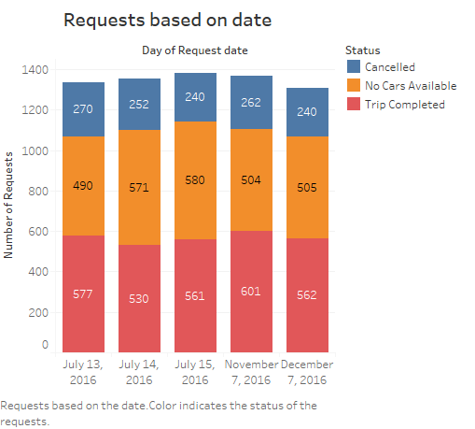
REQUESTS BASED ON THE DATE
The adjacent graph shows the number of requests based on the date.
It clearly indicates that
There is no significant difference in the number of requests made based on the date of the request.
There is a very slight but not significant difference in the number of requests completed , cancelled or the number of requests for which no cars were available.

Slide 6
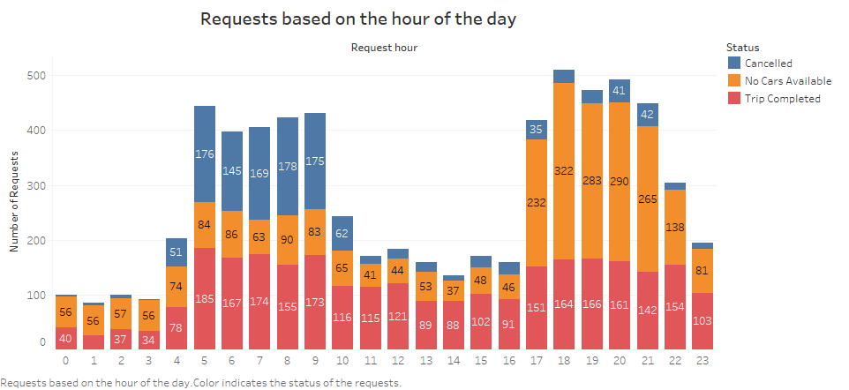
REQUESTS BASED ON THE HOUR OF DAY
The adjacent graph shows the number of requests based on the hour of the day.
It clearly indicates that
The number of requests made tend to increase between 5:00 A.M to 9:A.M and 5 P.M to 9 P.M.This might be due to arrival of most of the flights during that time.
There is no significant difference in the number of requests completed during these peak hours.
The number of requests cancelled during these peak hours is comparatively more in the mornings than in the evenings. This could be due to the traffic issues or more demand for the cars to other locations as it is the time people travel to their offices,schools,colleges etc.. Drivers might be more comfortable to go for other locations as they can avoid the waiting time in the Airport. They can complete more requests instead of waiting which can be more profitable.
The number of requests for which the re were no cars available during these peak hours is comparatively more in the evenings than in the mornings. This could be because most of the drivers would like to go back home after working for the day and don’t want to accept anymore requests.

Slide 7
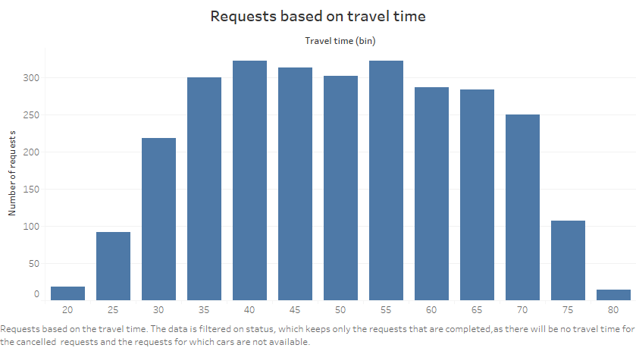
REQUESTS BASED ON THE TRAVEL DURATION
The adjacent graph shows the number of requests based on the time taken to complete the trip.
It clearly shows that
The travel duration ranges from 25 minutes to 1 hour 15 minutes for most of the trips.
This indicates that drivers would be interested to accept the requests for which the travel time ranges from 25 minutes to 1 hour 15 minutes .That is the drivers accept the requests for which the destination is neither too far nor too near from their current location assuming that the traffic doesn’t contribute much to the travel duration.

Slide 8
CONCLUSIONS
More than 50% of the requests were not completed either due to non availability of the cars or because the requests were cancelled.
The number of requests for which no cars were available are more from Airport to city than from City to Airport.
The number of requests which were cancelled were more from City to Airport than from Airport to City.
There is a very slight but not significant difference in the number of requests made, completed , cancelled or the number of requests for which no cars were available based on the date.
The number of requests made tend to increase between 5:00 A.M to 9:A.M and 5 P.M to 9 P.M.This might be due to arrival of most of the flights during that time.
There is no significant difference in the number of requests completed during these peak hours
The number of requests cancelled during these peak hours is comparatively more in the mornings than in the evenings.
The number of requests for which there were no cars available during these peak hours is comparatively more in the evenings than in the mornings
The travel duration ranges from 25 minutes to 1 hour 15 minutes for most of the trips.

Slide 9
SOLUTIONS SUGGESTED
Uber can provide the scheduled pickup facility so that customers can make the request beforehand and even the drivers can plan ahead and go for completing the requests.Uber needs to levy penalty if the drivers cancel the scheduled requests. Penalty should be based on the time slabs the drivers cancel the request. Heavy penalties should be levied if the drivers cancel the requests in the last moment. This will discourage them from cancelling the requests and accepting the requests only if it possible for them to complete. This will also help the customers in planning their trip properly and in avoiding the last minute tensions. If the waiting time is more customers should be additionally charged and more incentives should be paid to the drivers as they will lose on the other requests.
Uber can go for special cabs which take the requests from and to Airport only and the charges should be different from normal trips to encourage the drivers to accept the requests from or to Airport
Uber can collaborate with the airway companies to make the trip as a package along with the pick and drop car services so that the drivers will be stay updated with the flight arrival timings to pickup from or drop at the Airport.The drivers can avoid the waiting time and go for completing other requests based on the delay in the arrival of the flights.Customers would be more than happy to see the car arriving on time as they arrive at the Airport.This collaboration should be made mutually profitable.
Uber can also provide incentives or perks to the drivers who accept the requests with shorter and longer distances which will encourage the drivers who are close by and who are far away from the destination to accept the requests.

Slide 10
THANK YOU

